Slide 1
DB Design:
E/R Model

Slide 2
Today’s Lecture
How to communicate DBs with
x-teams, customers, stakeholders?
What are good designs?
Today’s Lecture

Slide 3


Database Design
Database design: Why do we need it?
Agree on structure of the database before deciding on a particular implementation
Consider issues such as:
What entities to model
How entities are related
What constraints exist in the domain
How to achieve good designs
Several formalisms exist
We discuss few flavors of E/R diagrams

Slide 4
1. E/R Basics: Entities & Relations

Slide 5
In this section
High-level motivation for the E/R model
Entities
Relations

Slide 6
Database Design Process
1. Requirements Analysis
2. Conceptual Design
3. Logical, Physical, Security, etc.
Requirements analysis
What is going to be stored?
How is it going to be used?
What are we going to do with the data?
Who should access the data?
Technical and non-technical people are involved

Slide 7
Database Design Process
1. Requirements Analysis
2. Conceptual Design
3. Logical, Physical, Security, etc.
2. Conceptual Design
A high-level description of the database
Sufficiently precise that technical people can reason about it
But, not so precise that non-technical people can’t participate
This is where E/R fits in.

Slide 8
Database Design Process
1. Requirements Analysis
2. Conceptual Design
3. Logical, Physical, Security, etc.
3. More:
Logical Database Design
Physical Database Design
Security Design

Slide 9
Database Design Process
1. Requirements Analysis
2. Conceptual Design
3. Logical, Physical, Security, etc.
This process is iterated many times
E/R Model & Diagrams used
name
name
category
price
Product
Makes
Company
E/R is a visual syntax for DB design which is precise enough for technical points, but abstracted enough for non-technical people

Slide 10
Interlude: Impact of the ER model
The E/R model is one of the most cited articles in Computer Science
“The Entity-Relationship model – toward a unified view of data” Peter Chen, 1976
Used by companies big and small

Slide 11
An example E/R diagram
name
category
since
name
price
makes
Company
Product
stockprice
buys
employs
Person
address
name
ssn

Slide 12
Entities and Entity Sets
Entities & entity sets are the primitive unit of the E/R model
Entities are the individual objects, which are members of entity sets
Ex: A specific person or product
Entity sets are the classes or types of objects in our model
Ex: Person, Product
These are what is shown in E/R diagrams - as rectangles
Entity sets represent the sets of all possible entities
In both Chen and Crow’s Foot models, entity is represented by rectangle containing entity’s name
Entity name, a noun, is usually written in capital letters
Product
Person
These represent entity sets

Slide 13















Slide 14
More on Attributes
Required Attributes: Not Null, Must have a value
Optional Attributes: Can have NULL values
Domain: Attribute set of possible values (Example: Marks range)
Attributes may share domain

Slide 15
Entities and Entity Sets
An entity set has attributes
Represented by ovals attached to an entity set
In Chen model, attributes are represented by ovals and are connected to entity rectangle with a line
Each oval contains the name of attribute it represents
In Crow’s Foot model, attributes are written in attribute box below entity rectangle
Shapes are important. Colors are not.
name
category
price
Product

Slide 16


Entities vs. Entity Sets
Example:
Entities are not explicitly represented in E/R diagrams!
Entity
name
category
price
Name: Xbox
Category: Total Multimedia System
Price: $250
Entity Attribute
Name: My Little Pony Doll
Category: Toy
Price: $25
Product
Product
Entity Set

Slide 17
Keys
A key is a minimal set of attributes that uniquely identifies an entity.
Denote elements of the primary key by underlining.
Here, {name, category} is not a key (it is not minimal).
If it were, what would it mean?
name
category
price
Product
The E/R model forces us to designate a single primary key, though there may be multiple candidate keys

Slide 18
Simple and Composite Attributes
Simple: (cannot be subdivided)
Age and gender etc.
Composite: (can be divided)
Address

Slide 19









Single and Multi-valued Attributes
Database Systems: Design, Implementation, & Management, 7th Edition, Rob & Coronel
Single: (can have single value)
CNIC and Passport number etc.
Multivalued: (can have many values)
Color of car and degrees etc.
Is single = simple?
Do not implement multivalued attributes in relational databases.
Can cause major structural problems
Create new entities for multivalued attribute’s components.

Slide 20
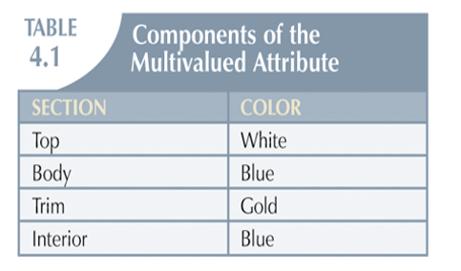
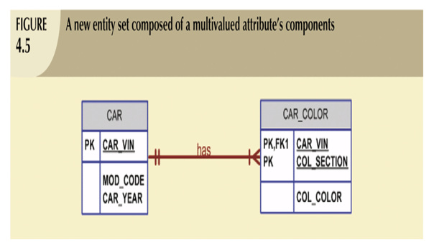










Slide 21







Derived Attribute/Computed Attribute
Derived from other attributes
Should we save it in database? (Pros/Cons)
No method in Crow Foot to represent it.
In Chen it is represented by dotted lines connected to entity set.

Slide 22


The R in E/R: Relationships
A relationship is between two entities
name
name
category
price
Product
Makes
Company

Slide 23
The R in E/R: Relationships
name
category
name
price
makes
Company
Product
stockprice
buys
employs
Person
address
name
ssn

Slide 24
Relationships
Participants
Connectivity: Relationship classification (1:1, 1:M and M:N)
Cardinality: Minimum and Maximum number of entity occurrences associated with one occurrence of related entity
Notes:
A CUSTOMER may generate many INVOICEs.
Each INVOICE is generated by one CUSTOMER

Slide 25
Next Lecture
Connectivity and Cardinality
More on relationships and entities

